Slide 1

LANE DETECTION SYSTEM
Abdul Ahad ⦿ Hamza Khursheed ⦿ Haram Iqbal ⦿ Shavaiz Butt

Slide 2
OBJECTIVES
Following are some of the objectives we are looking to achieve through this project
Accurate
Dynamic
Accessiblity
Be accurate while detecting lanes whether there is heavy traffic, no traffic in image, video or live footage.
Be adaptable to road conditions like road curves, color and other weather conditions like rain etc.
Be application on images, videos and live footages like dashcam footages etc. while also being small in size.

Slide 3





IDEATION PROCESS
COLOR MASK
DETECT EDGES
SEGEMENT
HOUGH TRANSFORM
DRAW LINES

Slide 4
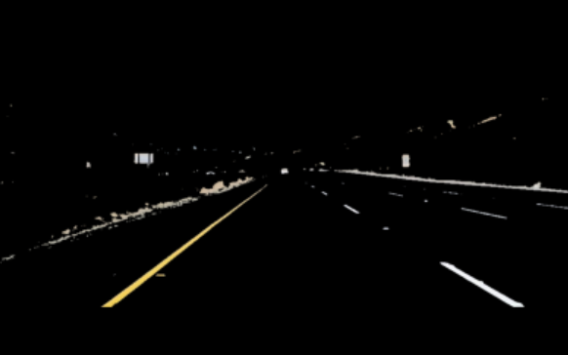

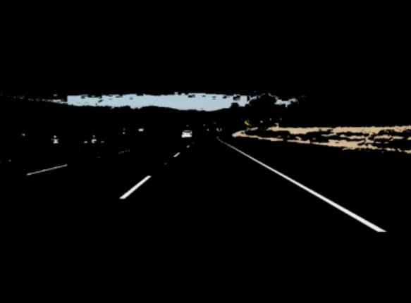
USING RGB
RGB lane detection has limitations due to sensitivity to lighting changes, struggles with diverse lane colors, is prone to noise in cluttered environments, and performs less reliably in non-standard or faded markings, low-light conditions, and adverse weather.

Slide 5
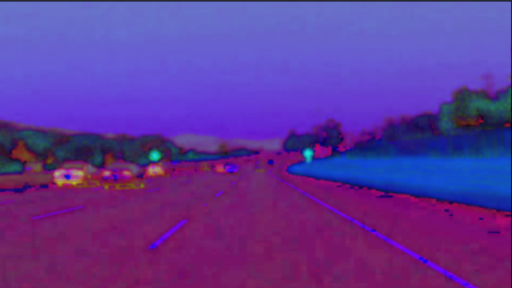
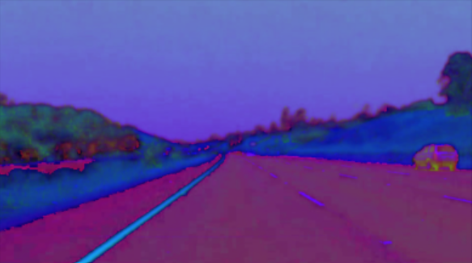
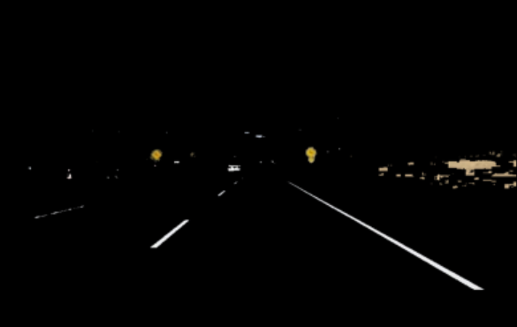
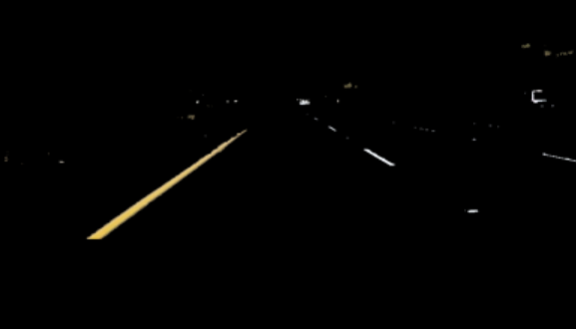
USING HSV
HSV simplifies color representation for lane detection, but it may struggle with color variation across different road environments and under complex lighting conditions, impacting accuracy.

Slide 6
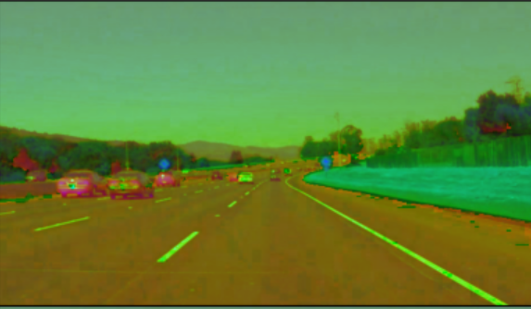
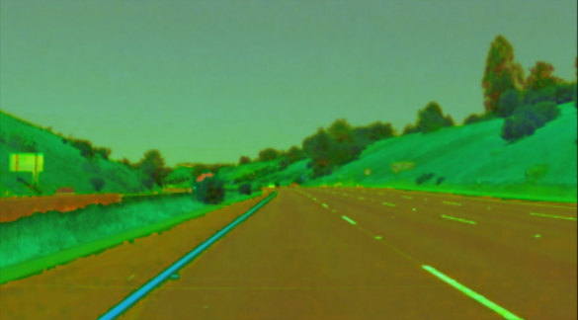
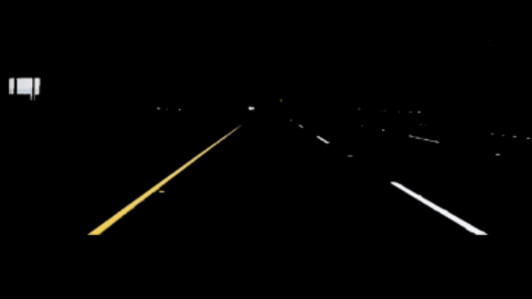
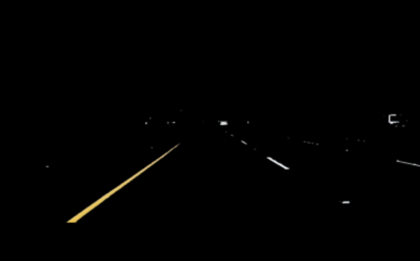
USING HSL
HSL offers advantages over RGB and HSV in lane detection due to its ability to represent color variations and luminance separately. It combines the benefits of both models, making it versatile for accurate lane identification in different lighting conditions.

Slide 7


COLOR MASKING
Since lanes all over the work are either white or yellow, so we mask out these colors to make lane detection more accurate.

Slide 8
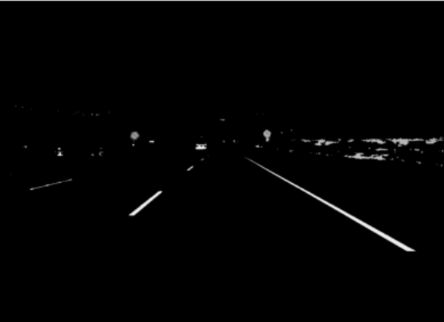
GRAYSCALING
The Canny edge detection algorithm measures the intensity gradients of each pixel. So, we need to convert the images into gray scale to detect edges.

Slide 9
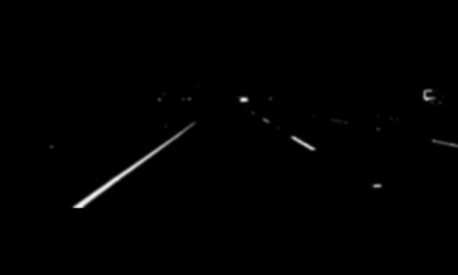
GAUSSIAN SMOOTHING
To smooth the image, a Gaussian filter is applied to convolve with the image. This step will slightly smooth the image to reduce the effects of obvious noise on the edge detector..

Slide 10
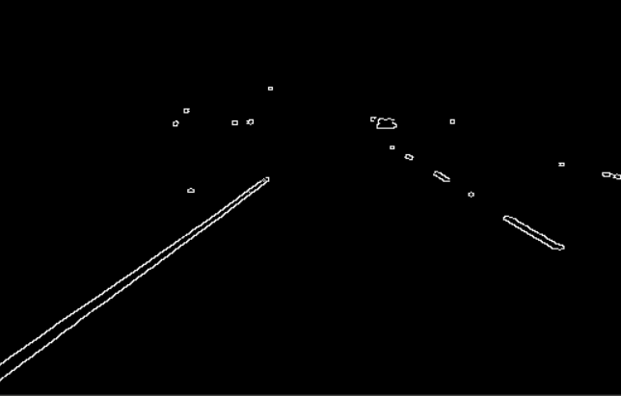
EDGE DETECTION
Next, we remove the noise using Gaussian Blur and apply canny edge detection using lower threshold of 50 and upper threshold of 100

Slide 11
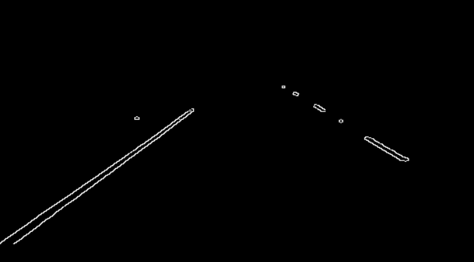
IMAGE SEGMENTATION
After canny edge detection, we use this information to segment out our region of interest, which is our lane in this case.

Slide 12
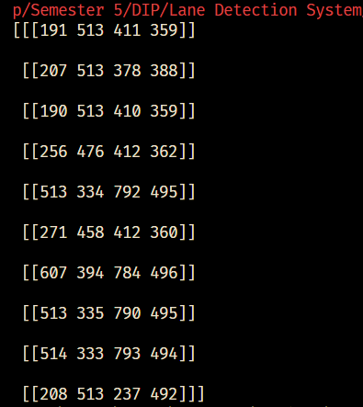
HOUGH TRANSFORM
We use probabilistic hough transform to get the vectors of lanes, which would be helpful for plotting lines after this.

Slide 13
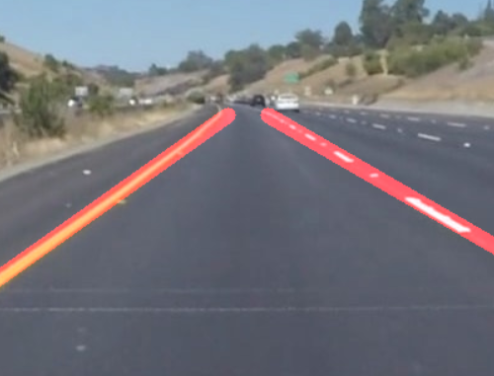
PLOT LINES
After we get the vectors, we plot the lines on the image by calculating the slope, x-coordinates and y-coordinates of the lines.

Slide 14
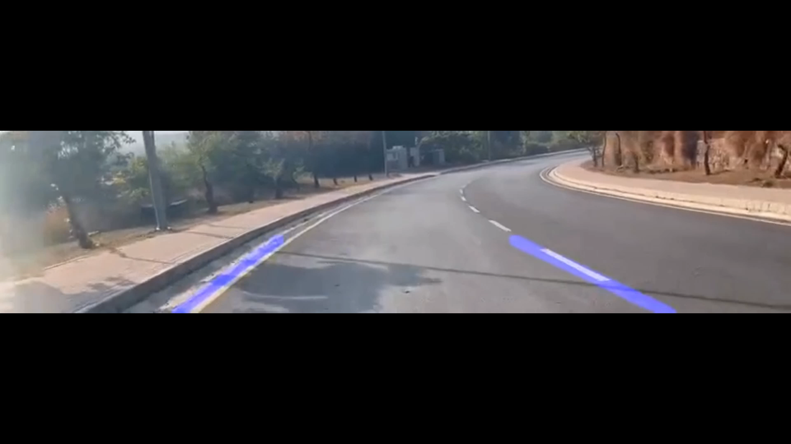
EXAMPLE VIDEO
After we get the vectors, we plot the lines on the image by calculating the slope, x-coordinates and y-coordinates of the lines.

Slide 15
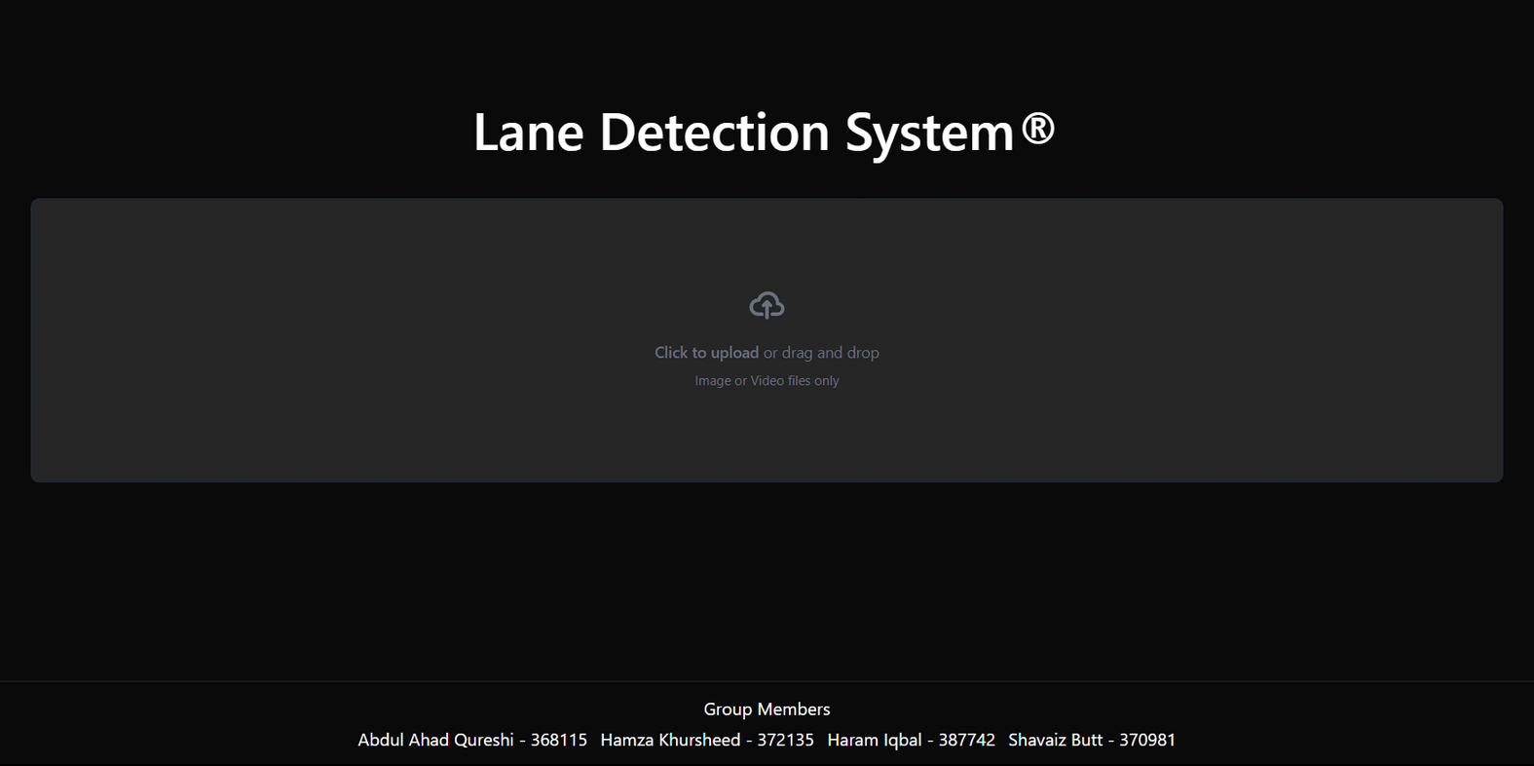
CRAFTING FRONTEND

Slide 16
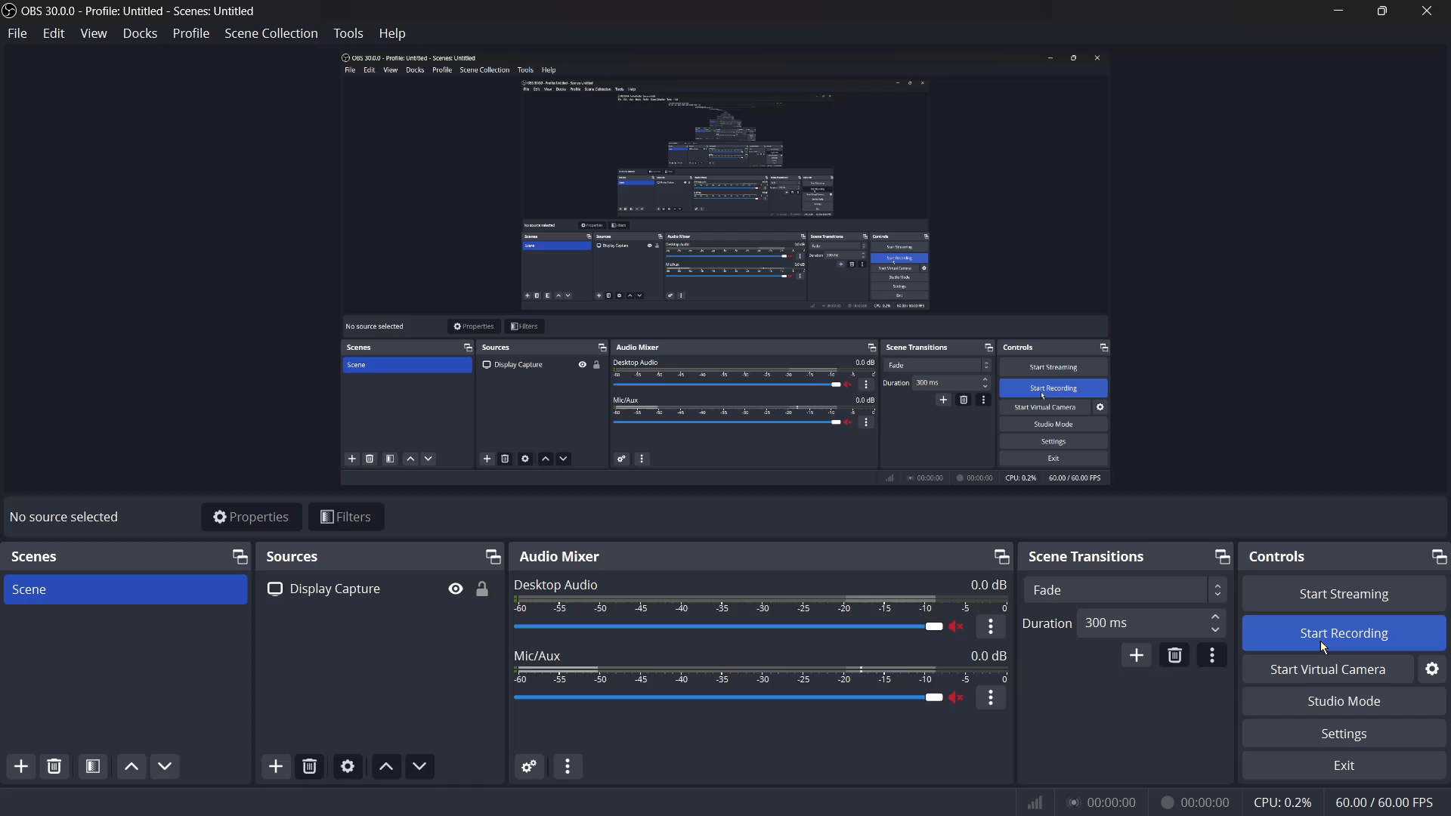
PREVIEW

Slide 17
THANK YOU.
Feel Free to ask any questions, suggestions or improvement tips!

